Slide 1


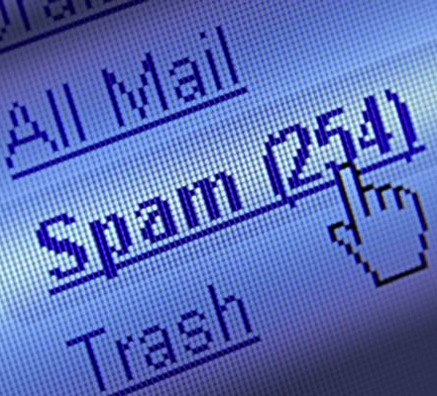

Cybercrime
INGI2347: COMPUTER SYSTEM SECURITY (Spring 2015)
Marco Canini
Lecture slides adapted from Upenn CSE331 by Steve Zdancewic and UC Berkeley CS161 by Vern Paxson Reproduced with permission
Notes:
Image source: http://www.scmagazine.com/top-five-data-breaches-in-2013so-far/slideshow/1387/# http://cnet3.cbsistatic.com/hub/i/2014/01/30/836ede54-a5e1-11e3-a24e-d4ae52e62bcc/b906ebb2ab1b8935c509a7c9d61f52d3/Internet5_610x426.jpg

Slide 2
Outline
Distributed DoS (DDoS)
Botnets
Spam & Spam Profit
The Rise of the Underground Economy

Slide 3
Distributed DoS (DDoS)

Slide 4
Attacks on Availability
Denial-of-Service (DoS, or “doss”): keeping someone from using a computing service
How broad is this sort of threat?
Very: huge attack surface
We do though need to consider our threat model …
What might motivate a DoS attack?

Slide 5
Motivations for DoS
Showing off / entertainment / ego
Competitive advantage
Maybe commercial, maybe just to win
Vendetta / denial-of-money
Extortion
Political statements
Impair defenses
Espionage
Warfare

Slide 7
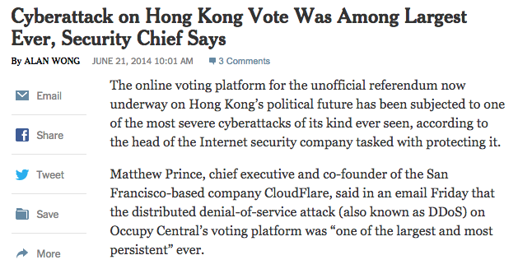
http://nyti.ms/1leJtEd

Slide 8
Attacks on Availability
Denial-of-Service (DoS, or “doss”): keeping someone from using a computing service
How broad is this sort of threat?
Very: huge attack surface
We do though need to consider our threat model …
What might motivate a DoS attack?
Two basic approaches available to an attacker:
Deny service via a program flaw (“*NULL”)
E.g., supply an input that crashes a server or cause system shutdown
Deny service via resource exhaustion (“while(1);”)
E.g., consume CPU, memory, disk, network

Slide 9
DoS Defense in General Terms
Defending against program flaws requires:
Careful authentication
Don’t obey shut-down orders from imposters
Careful coding/testing/review
Consideration of behavior of defense mechanisms
E.g. buffer overflow detector that when triggered halts execution to prevent code injection ⇒ denial-of-service
Defending resources from exhaustion can be really hard. Requires:
Isolation mechanisms
Keep adversary’s consumption from affecting others
Reliable identification of different users
Know who the adversary is in the first place!

Slide 10
DoS & Operating Systems
How could you DoS a multi-user Unix system on which you have a login?
# rm -rf /
(if you have root - but then just “halt” works well!)
char buf[1024]; int f = open("/tmp/junk"); while (1) write(f, buf, sizeof(buf));
Gobble up all the disk space!
while (1) fork();
Create a zillion processes!
Create zillions of files, keep opening, reading, writing, deleting
Thrash the disk
… doubtless many more
Defenses?
Isolate users / impose quotas

Slide 11
DoS & Networks
How could you DoS a target’s Internet access?
Send a zillion packets at them
Internet lacks isolation between traffic of different users!
What resources does attacker need to pull this off?
At least as much sending capacity (“bandwidth”) as the bottleneck link of the target’s Internet connection
Attacker sends maximum-sized packets
Or: overwhelm the rate at which the bottleneck router can process packets
Attacker sends minimum-sized packets!
(in order to maximize the packet arrival rate)

Slide 12
Defending Against Network DoS
Suppose an attacker has access to a beefy system with high-speed Internet access (a “big pipe”)
They pump out packets towards the target at a very high rate
What might the target do to defend against the onslaught?
Install a network filter to discard any packets that arrive with attacker’s IP address as their source
E.g., drop * 66.31.1.37:* -> *:*
Or it can leverage any other pattern in the flooding traffic that’s not in benign traffic
Filter = isolation mechanism
Attacker’s IP address = means of identifying misbehaving user

Slide 13
Filtering Sounds Pretty Easy …
… but it’s not. What steps can the attacker take to defeat the filtering?
Make traffic appear as though it’s from many hosts
Spoof the source address so it can’t be used to filter
Just pick a random 32-bit number of each packet sent
How does a defender filter this?
They don’t!
Best they can hope for is that operators around the world implement anti-spoofing mechanisms (today about 75% do)
Use many hosts to send traffic rather than just one
Distributed Denial-of-Service = DDoS (“dee-doss”)
Requires defender to install complex filters
How many hosts is “enough” for the attacker?
Today they are very cheap to acquire … :-(

Slide 14
It’s Not A “Level Playing Field”
When defending resources from exhaustion, need to beware of asymmetries, where attackers can consume victim resources with little comparable effort
Makes DoS easier to launch
Defense costs much more than attack
Particularly dangerous form of asymmetry: amplification
Attacker leverages system’s own structure to pump up the load they induce on a resource

Slide 15
Amplification: Network DoS
One technique for magnifying flood traffic: leverage Internet’s broadcast functionality

Slide 16
Amplification: Network DoS
One technique for magnifying flood traffic: leverage Internet’s broadcast functionality
How does an attacker exploit this?
Send traffic to the broadcast address and spoof it as though the DoS victim sent it
All of the replies then go to the victim rather than the attacker’s machine
Each attacker pkt yields dozens of flooding pkts
smurf attack

Slide 17
Smurf Example
ICMP Echo Replies
Victim
LAN
Host
Internet
IP: 3.3.3.3
LAN
Host
ICMP Echo Request Source (spoofed): 3.3.3.3 Destination (broadcast): 2.2.2.255
Real IP: 1.1.1.1
LAN
Host
Attacker

Slide 18
Amplification: Network DoS
One technique for magnifying flood traffic: leverage Internet’s broadcast functionality
How does an attacker exploit this?
Send traffic to the broadcast address and spoof it as though the DoS victim sent it
All of the replies then go to the victim rather than the attacker’s machine
Each attacker pkt yields dozens of flooding pkts
Another example: DNS lookups
Reply is often much bigger than request
So attacker spoofs request seemingly from the target
Small attacker packet yields large flooding packet
smurf attack

Slide 19
Transport-Level Denial-of-Service
Recall TCP’s 3-way connection handshake
Goal: agree on initial sequence numbers
So a single SYN from an attacker suffices to force the server to spend some memory
Client (initiator)
Server
SYN, SeqNum = x
Server creates state associated with connection here
SYN + ACK, SeqNum = y, Ack = x + 1
Attacker doesn’t even need to send this ack
ACK, Ack = y + 1

Slide 20
TCP SYN Flooding
Attacker targets memory rather than network capacity
Every (unique) SYN that the attacker sends burdens the target
What should target do when it has no more memory for a new connection?
No good answer!
Refuse new connection?
Legit new users can’t access service
Evict old connections to make room?
Legit old users get kicked off

Slide 21
TCP SYN Flooding
How can the target defend itself?
Approach #1: make sure they have tons of memory!
How much is enough? Depends on resources attacker can bring to bear

Slide 22
TCP SYN Flooding
Approach #2: identify bad actors & refuse their connections
Hard because only way to identify them is based on IP address
We can’t for example require them to send a password because doing so requires we have an established connection!
For a public Internet service, who knows which addresses customers might come from?
Plus: attacker can spoof addresses since they don’t need to complete TCP 3-way handshake
Approach #3: don’t keep state! (“SYN cookies” ; only works for spoofed SYN flooding)

Slide 23
TCP SYN Flooding
Approach #4: spread service across lots of different physical servers
This is a general defense against a wide range of DoS threats (including application-layer)
If servers are at different places around the network, protects against network-layer DoS too
But: costs $$
And: some services are not easy to divide up
Such as when need to modify common database

Slide 24
Application-Layer DoS
Rather than exhausting network or memory resources, attacker can overwhelm a service’s processing capacity
There are many ways to do so, often at little expense to attacker compared to target (asymmetry)

Slide 25
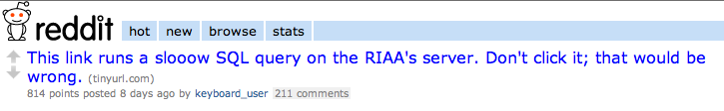
The link sends a request to the web server that requires heavy processing by its “backend database”
(Such queries are usually written in a language called SQL, as we’ll see next lecture)

Slide 26
Application-Layer DoS
Rather than exhausting network or memory resources, attacker can overwhelm a service’s processing capacity
There are many ways to do so, often at little expense to attacker compared to target (asymmetry)
Defenses against such attacks?
Approach #1: Only let legit users to issue expensive requests
Relies on being able to identify/authenticate them (e.g., CAPTCHAs)
Note: that this itself might be expensive!
Approach #2: Look for clusters of similar activity
Arms race with attacker AND costs collateral damage
Approach #3: distribute service across multiple servers ($$$)

Slide 27
DDoS Recent Examples
Jun 2014 – Hong Kong’s Occupy Central voting platform hit by 300+ Gbps DDoS
Feb 2014 – 400 Gbps NTP amplification DDoS attack against an organization in Europe
Mar 2013 – 300 Gbps DDoS attack against Spamhaus
Oct 2012 – HSBC experienced a downtime of many of its website worldwide
Aug 2012 – WikiLeaks was hit by a DDoS attack
Jun 2012 – CIA website fallen foul of a DDoS attack
Mar 2011 – WordPress.com suffered a large DDoS attack

Slide 28
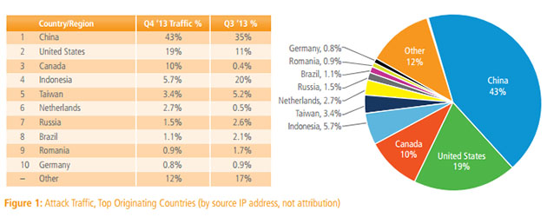
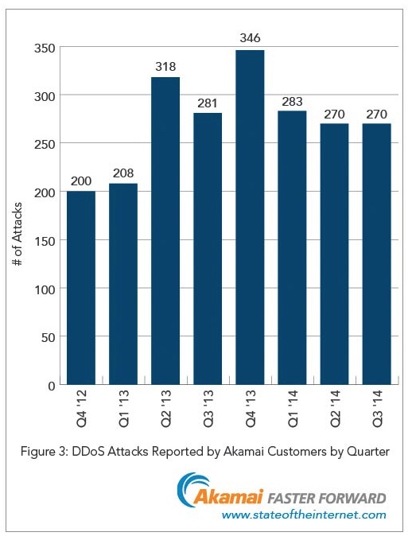
Akamai’s State of the Internet Report

Slide 29
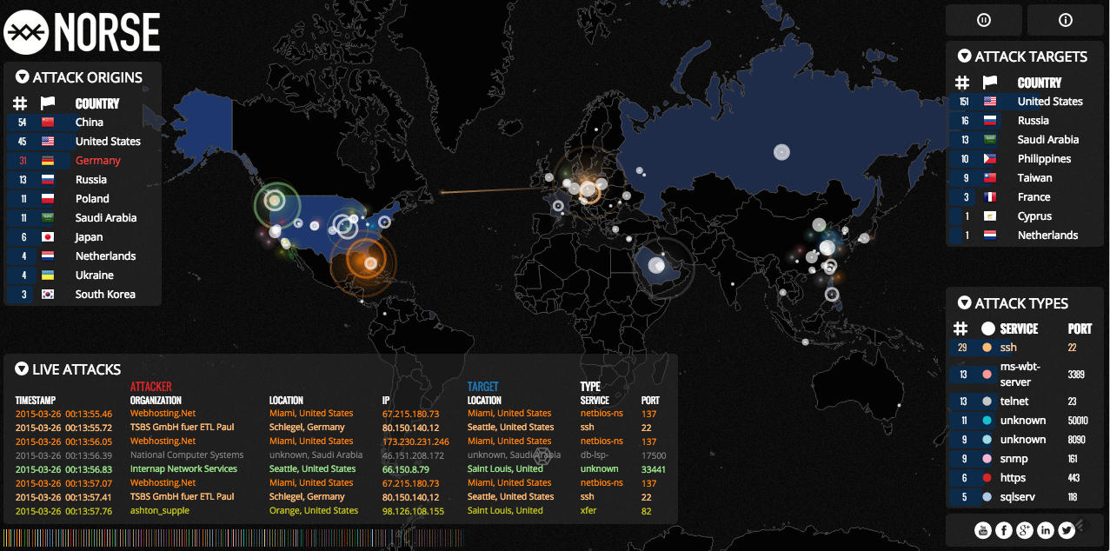
Let’s watch some live attacks ...
http://map.ipviking.com/

Slide 30
Botnets

Slide 31
Botnets
Collection of compromised machines (bots) under (unified) control of an attacker (botmaster)
Method of compromise decoupled from method of control
Launch a worm / virus / drive-by infection / etc.
Upon infection, new bot “phones home” to rendezvous with botnet command-and-control (C&C)
Lots of ways to architect C&C:
Star topology; hierarchical; peer-to-peer
Encrypted/stealthy communication
Botmaster uses C&C to push out commands and updates

Slide 32

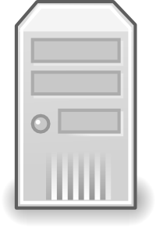


The Storm Botnet
Botmaster
Hosted infrastructure
Master servers
HTTP
Proxy
bots
Infected machines
TCP
Workers

Slide 33
Example of C&C Messages
Activation (report from bot to botmaster)
Email address harvests
Spamming instructions
Delivery reports
DDoS instructions
FastFlux instructions (rapidly changing DNS)
HTTP proxy instructions
Sniffed passwords report
IFRAME injection/report
From the “Storm” botnet ~2008

Slide 34
Fighting Bots / Botnets
How can we defend against bots / botnets?
Approach #1: prevent the initial bot infection
Equivalent to preventing malware infections in general …. HARD
Approach #2: take down the C&C master server
Find its IP address, get associated ISP to pull plug

Slide 36
Fighting Bots / Botnets
How can we defend against bots / botnets?
Approach #1: prevent the initial bot infection
Equivalent to preventing malware infections in general …. HARD
Approach #2: Take down the C&C master server
Find its IP address, get associated ISP to pull plug
Botmaster countermeasures?
Counter #1: keep moving around the master server
Bots resolve a domain name to find it (e.g. c-and-c.evil.com)
Rapidly alter address associated with name (“fast flux”)
Counter #2: buy off the ISP …

Slide 37
Fighting Bots / Botnets
Approach #3: seize the domain name used for C&C
This is what’s currently often used, often to good effect …
… Botmaster counter-measure?
Each day (say), bots generate large list of possible domain names using a Domain Generation Algorithm
Large = 50K, in some cases
Bots then try a random subset looking for a C&C server
Server signs its replies, so bot can’t be duped
Attacker just needs to hang on to a small portion of names to retain control over botnet
This is becoming state-of-the-art …
Counter-counter measure?
Behavioral signature: look for hosts that make a lot of failed DNS lookups (research)

Slide 38
Addressing The Botnet Problem
What are our prospects for securing the Internet from the threat of botnets? What angles can we pursue?
Angle #1: detection/cleanup
Detecting infection of individual bots hard as it’s the defend-against-general-malware problem
Detecting bot doing C&C likely a losing battle as attackers improve their sneakiness & crypto
Cleanup today lacks oomph:
Who’s responsible? … and do they care? (externalities)
Landscape could greatly change with different model of liability
Angle #2: go after the C&C systems / botmasters
Difficult due to ease of Internet anonymity & complexities of international law
But: a number of recent successes in this regard
One promising angle: policing domain name registrations

Slide 39
Addressing The Problem
Angle #3: prevention
Bots require installing new executables or modifying existing ones
Perhaps via infection …
… or perhaps just via user being fooled / imprudent
Better models?
We could lock down systems so OS prohibits user from changing configuration
Sacrifices flexibility
How does this work for home users?
Can we leverage trusted kernels + white lists / code signing?
Or: structure OS/browser so code runs with Least Privilege
Does this solve the problem?
Depends on how granular the privileges are … and how the decision is made regarding just what privileges are “least”
E.g., iTunes App Store model (vetting), Android model (user confirmation)

Slide 40
Spam & Spam Profit

Slide 41
Spam email
Unsolicited automated email; sent in bulk to numerous recipients
(The sender is a stranger to the recipient)
The sender address is (almost) always forged to prevent counterattacks
Basic SMTP (Simple Mail Transfer Protocol) does not perform any verification of the sender’s address, it is easy to forge mails

Slide 42
Spamming Techniques
Method #1: Use of own/ISP SMTP server
Method #2: Abuse of open relays
A single message sent to the mail server can be relayed to thousands of addresses
Method #3: Abuse a webmail account
Create fake webmail accounts and send spam through them
Method #4: Infect computers
Take control of infected computers to send spam

Slide 43
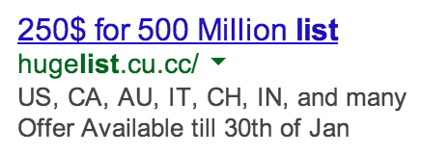
How do spammers harvest emails?
Just buy a list of emails
Crawl the Web
Mailing lists & newsgroups
Hack into a database
Scan files on infected machines
Hoax, scam and chain letters
By guessing (dictionary, brute force, standard)

Slide 44
Stopping Spam
Anti-Spam laws
Legislation to restrict use of email spam in several countries
Protection via a technical solution
Filters
“I think it’s possible to stop spam, and that content-based filters are the way to do it. The Achilles heel of the spammers is their message. They can circumvent any other barrier you set up. They have so far, at least. But they have to deliver their message, whatever it is. If we can write software that recognizes their messages, there is no way they can get around that” – Paul Graham, 2002
Black/white/grey lists

Slide 45
Filters
Feature-recognizing filters
Rules that recognize individual properties of spam
E.g. mentions “Viagra”, has all uppercase subject, etc.
Assign a spam “score” to email
How many points should an email get for having the word “drug” in it?
Statistical filtering based on the Bayesian approach
Proposed by Paul Graham in 2002 (http://www.paulgraham.com/spam.html)
Trained on user’s email labeled as spam vs. not spam
Assigns each message with a probability of being spam
Filters are not perfect and can not prevent false positives or false negatives
Notes:
Explain what are false positive and false negative.

Slide 46
Black/White/Grey Lists
Servers use lists to decide the acceptance of emails
E.g. Spamhaus SBL and XBL lists
http://www.spamhaus.org/
SBL: IPs of known spam operators
XBL: IPs of hijacked systems relying spams
Challenges:
Maintain lists up to date
Whitelisting requires senders to be known a priori
Greylisting (block a mail if the behavior of the sender’s server is abnormal) introduces delivery delays (while user behavior is checked)

Slide 47
Monetizing Spam
In what different ways can spammers make money off of sending spam?
And who has incentives to thwart these schemes?
(Other than law enforcement)
Scheme #1: advertise goods or services
Examples: fake Rolexes, Viagra, university degrees
Profit angle: increased sales
Who’ll try to stop: brand holders

Slide 48
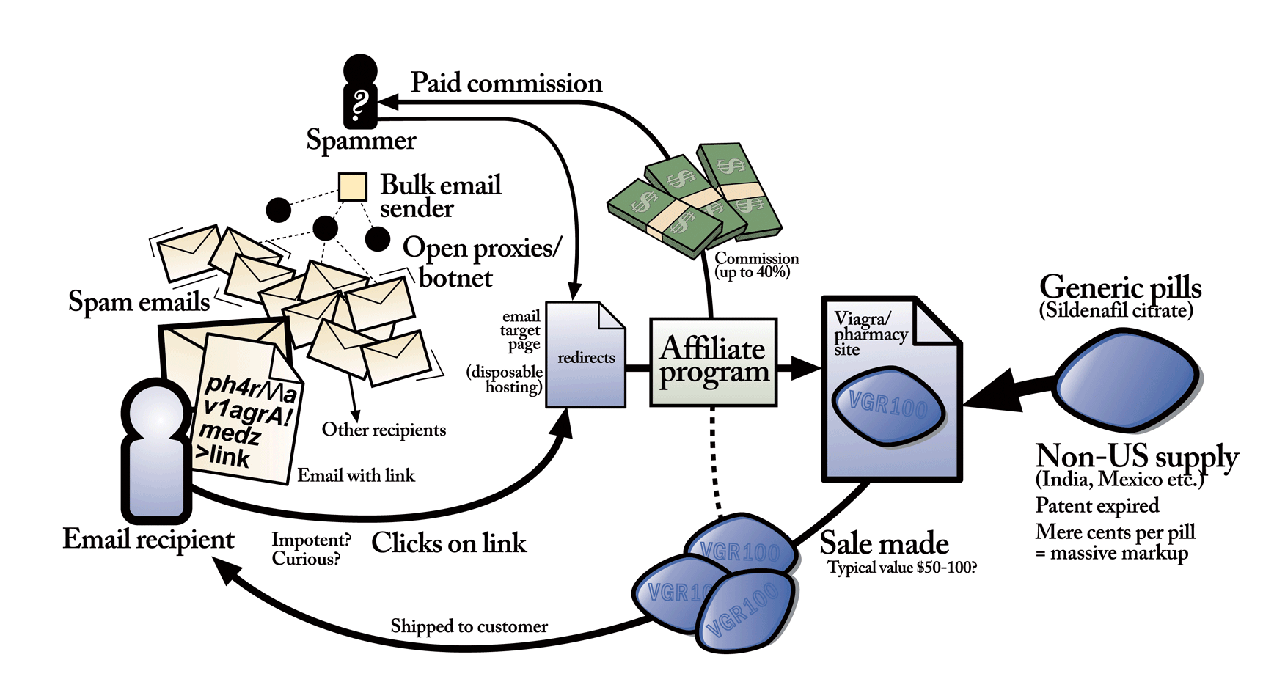
Anatomy of a modern Pharma spam campaign
Diagram by Stuart Brown
http://modernlifeisrubbish.co.uk

Slide 49
Monetizing Spam
In what different ways can spammers make money off of sending spam?
And who has incentives to thwart these schemes?
(Other than law enforcement)
Scheme #1: advertise goods or services
Examples: fake Rolexes, Viagra, university degrees
Profit angle: increased sales
Who’ll try to stop: brand holders
Scheme #2: phishing
Profit angle: transfer $$$ out of accounts; sell accounts to others; use accounts for better spamming (e.g. Facebook)
Opponents: issuers of accounts
Note: targeted phishing (“spear-phishing”) doesn’t actually need much in the way of spam due to low volume

Slide 50
Monetizing Spam
Scheme #3: scams
Examples: pen pal relationships, 419 (“Nigerian”)
Profit angle: con victim into sending money
Opponents: scambaiters (e.g., www.419eater.com)
Scheme #4: recruiting crooks/underlings
Examples: money mules, re-shippers
Profit angle: enables profiting from cybercrime
Opponents: ?

Slide 51
Monetizing Spam
Scheme #3: scams
Examples: pen pal relationships, 419 (“Nigerian”)
Profit angle: con victim into sending money
Opponents: scambaiters (e.g., www.419eater.com)
Scheme #4: recruiting crooks/underlings
Examples: money mules, re-shippers
Profit angle: enables profiting from cybercrime
Opponents: ?
Money mules take incoming (fraudulent) financial transfers to their bank accounts, wire-transfer 90% out of country, keep 10%

Slide 52
Monetizing Spam
Scheme #3: scams
Examples: pen pal relationships, 419 (“Nigerian”)
Profit angle: con victim into sending money
Opponents: scambaiters (e.g., www.419eater.com)
Scheme #4: recruiting crooks/underlings
Examples: money mules, re-shippers
Profit angle: enables profiting from cybercrime
Opponents: ?
Re-shippers receive shipments of goods (e.g., a laptop bought using a stolen account) and re-mail them outside the country

Slide 53
Monetizing Spam
Scheme #5: pump-and-dump
Example: “Falcon Energy (FPK) is about to go through the roof! Don’t miss out on $eriou$ Profit$!”
Profit angle: penny-stock momentarily goes up, dump pre-bought shares when it does
Opponents: Securities and Exchange Commission
Note: unlike other monetization techniques, the “back channel” is out-of-band
No link in messages back to the scammer
Scheme #6: recruiting bots
Examples: “important security patch!”, “someone sent you a greeting card!”
Profit angle: get malware installed on new machines
Opponents: ?

Slide 54
The Rise of the Underground Economy

Slide 55
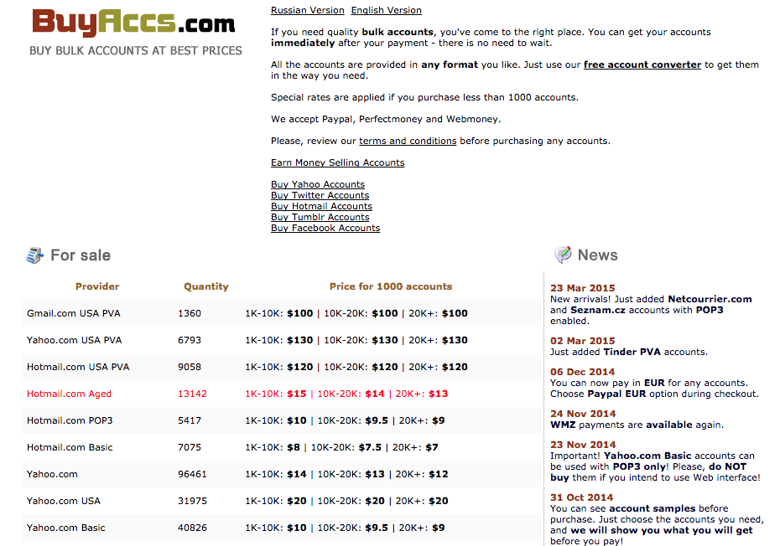

Slide 56
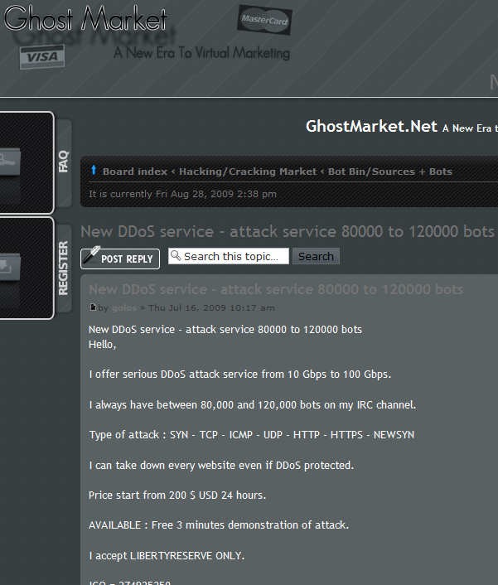

Slide 57
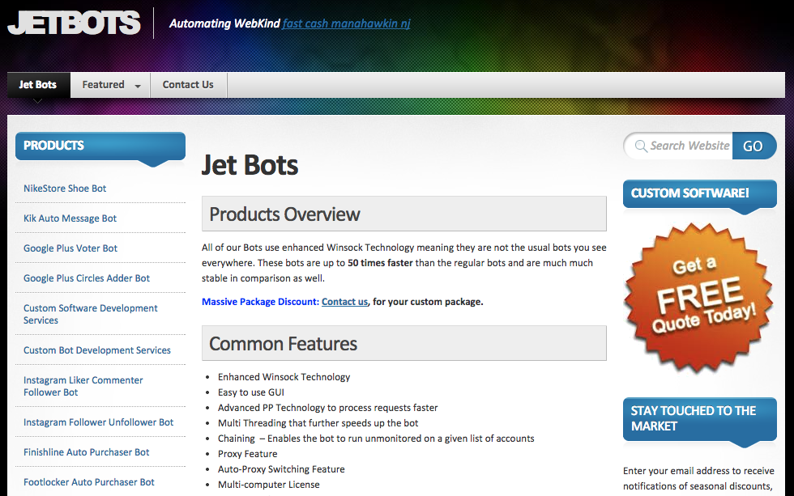

Slide 58
Underground Economy IRC Market
Good or Service | Percent of offerings | Asking price range
Bank account credentials | 18% | $10-$1000
Credit Card Numbers (with CCV2) | 16% | $0.50-$12
Credit Cards | 13% | $0.1-$25
Email addresses | 6% | $0.30/MB - $40/MB
Email passwords | 6% | $4 - $30
Full identities | 6% | $0.90 - $25
Cashout Services | 5% | 8%-50% of total value
Proxies | 4% | $0.30 - $20
Scams | 3% | $2.5-$100/week for hosting
Mailers | 3% | $1-$25
“Nobody Sells Gold for the Price of Silver: Dishonesty, Uncertainty and the Underground Economy,” Herley, Florencio

Slide 59
Pay-Per-Install Ecosystem
“Measuring Pay-per-Install: The Commoditization of Malware Distribution,” Caballero et al.
Clients
Pay the PPI
Want malware installed
Spambots, information harvesting, rootkits, fake AV

Slide 60
Pay-Per-Install Ecosystem
Clients
Pay the PPI
Want malware installed
Spambots, information harvesting, rootkits, fake AV
Pay-per-install (PPI)
Purchase compromised hosts from affiliates
Resells to clients

Slide 61
Pay-Per-Install Ecosystem
Clients
Pay the PPI
Want malware installed
Spambots, information harvesting, rootkits, fake AV
Pay-per-install (PPI)
Purchase compromised hosts from affiliates
Resells to clients
Affiliates
Compromise machines
Execute the PPI’s binaries

Slide 62


Slide 63
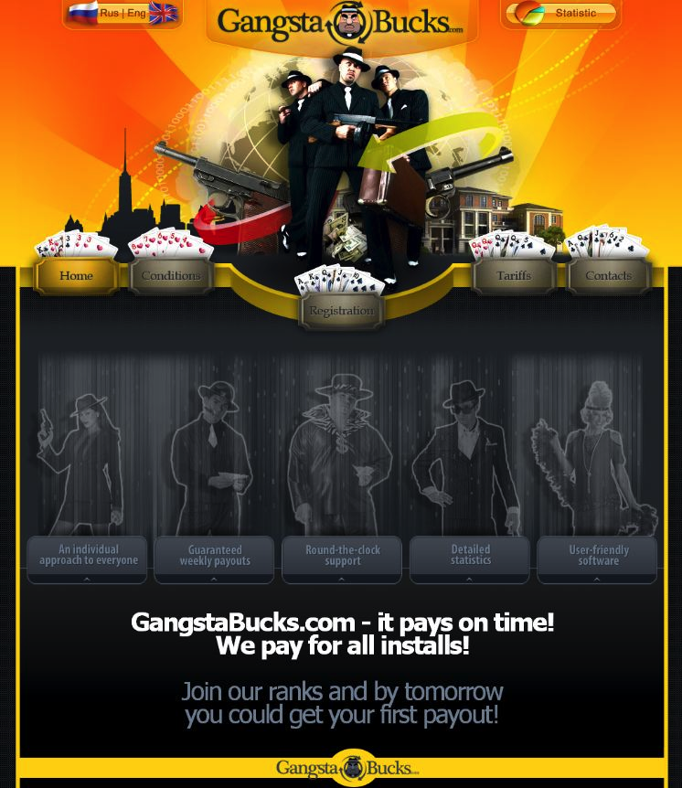

Slide 64
The Underground Economy
Why is its emergence significant?
Markets enable efficiencies
Specialization: individuals rewarded for doing a single thing particularly well
Lowers barrier-to-entry
Only need a single skill
Some underground market activities are legal
Competition spurs innovation
Accelerates arms race
Defenders must assume a more pessimistic threat model
Facilitates non-$ Internet attacks (political, nation-state)
Provides actors with cheap attack components
Provides stealthy actors with plausible cover

Slide 65
The Underground Economy
What problems do underground markets face?
Depending on marketplace architecture, can present a target / single point of failure
By definition, deals are between crooks
Major issue of betrayal by “rippers”
Markets only provide major efficiencies if they facilitate deals between strangers
Susceptible to infiltration

Slide 66
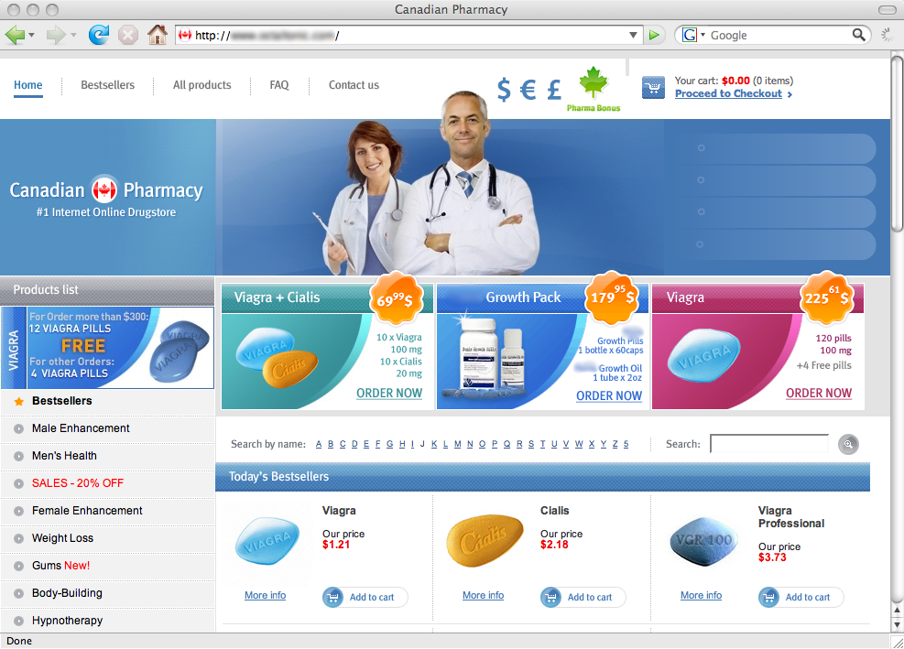
Welcome to Storm! What can we sell you?

Slide 67
Life As A Spammer …
“Spamalytics: An Empirical Analysis of Spam Marketing Conversion,” Kanich et al.
Storm infiltration study found:
Modern spam campaigns can send 10s of billions of spams using mailing lists of 100s of millions of addresses
3/4 to 5/6 of all spam delivery attempts fail before the message is even sent to the receiver’s server …
… due to heavy & effective use of black-listing
It takes around 20,000 “postcard” spams to get one person to visit the postcard site
1 in 10 of the visitors will click to download the postcard
It takes around 12,000,000 Viagra spams to get one person to visit the site and make a purchase (~$100)
Even given those low rates, huge volume ⇒ profitable
~ $1.5-2M/year revenue

Slide 68
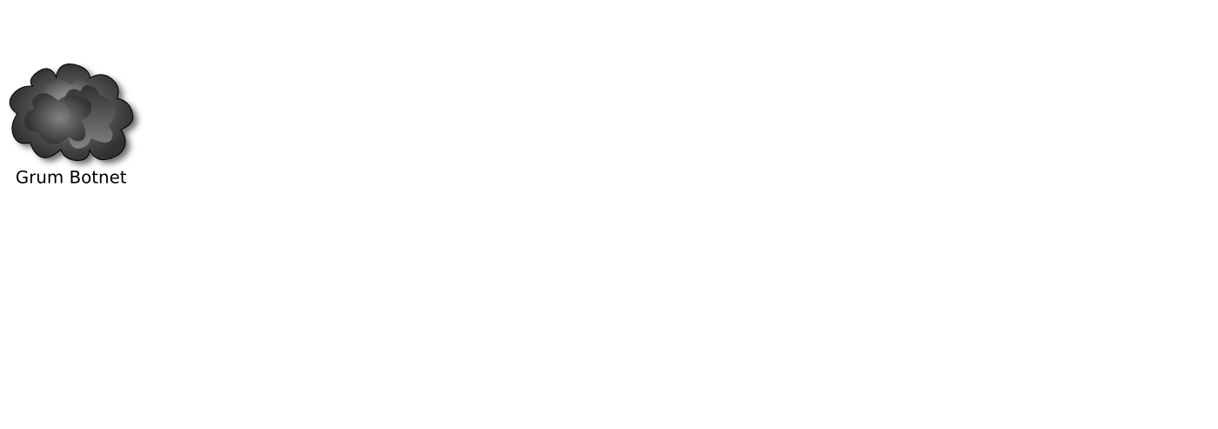
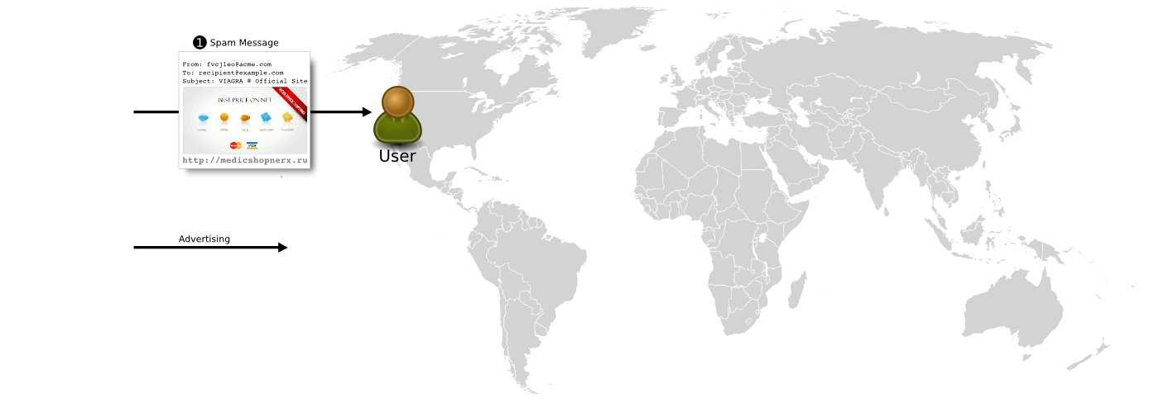

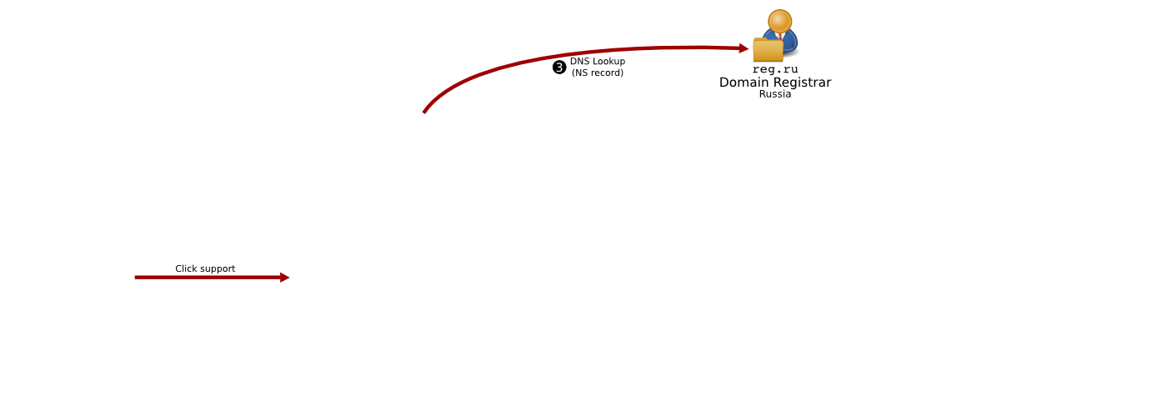
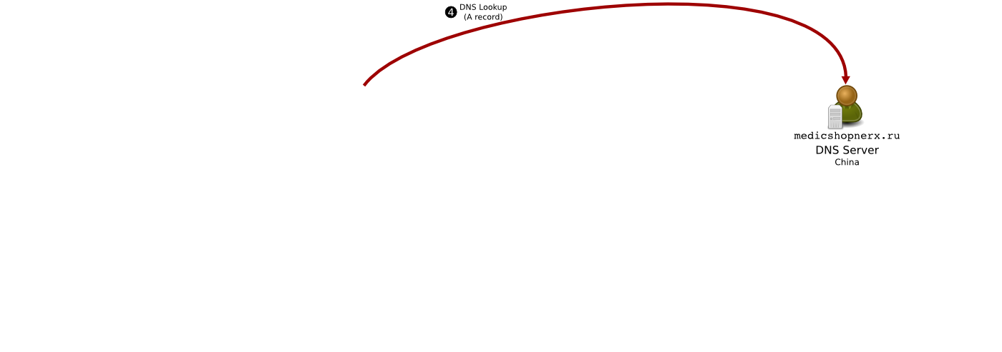

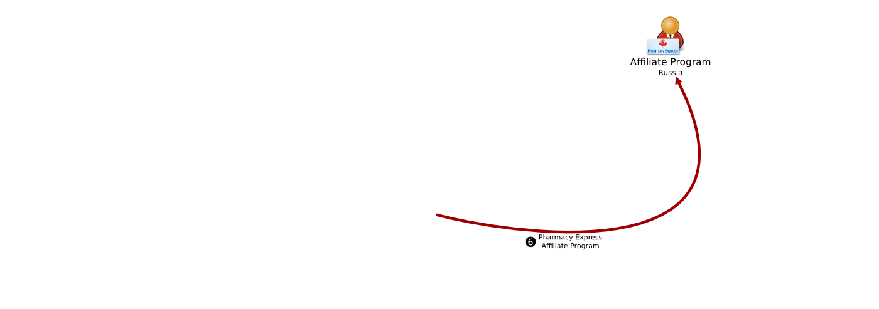
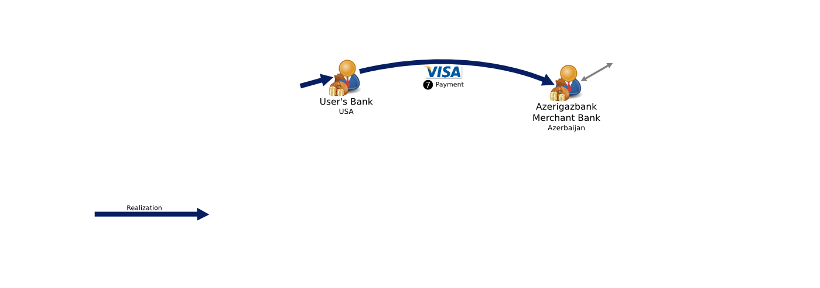
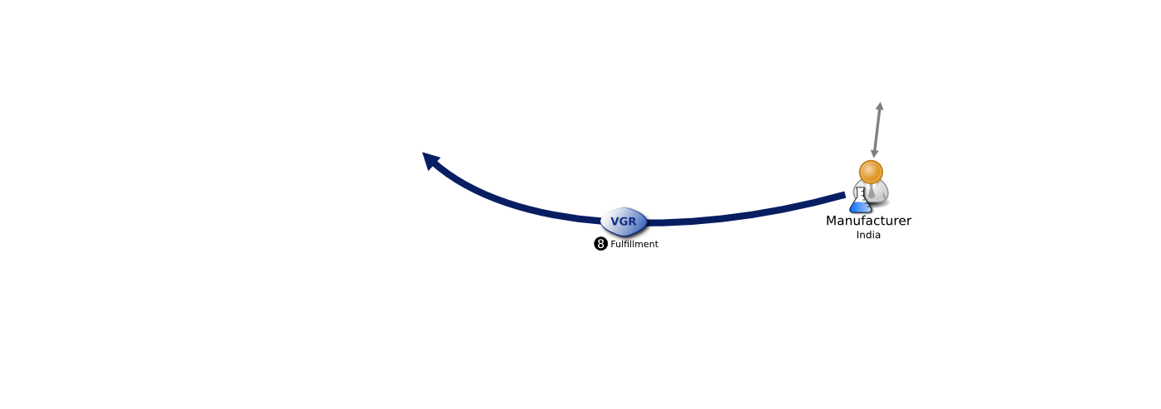
Phases of the Spam Value Chain
“Click Trajectories: End-to-End Analysis of the Spam Value Chain,” Levchenko et al.
If we were to “snip” a link in this chain, which one would be the most disruptive for our least expenditure?
Measuring URLs, DNS servers, HTTP redirection, etc. all a matter of energetic crawling & recording.
But merchant banks / Visa / “fulfillment”?

Slide 69
Harming the Spam Value Chain
Study based on making purchases of spam-advertised pharmaceuticals found that 3 merchant banks hosted 95+% of all sales …
… suggesting a novel way to suppress spam is to undermine the credit-card processing

Slide 70
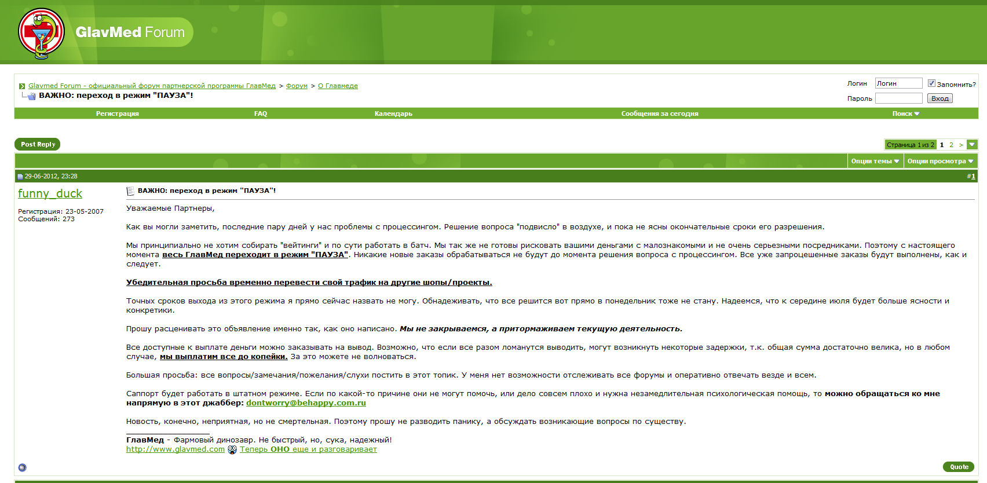
6/29/2012
Dear Partners, As you may have noticed, in the last couple of days we've had problems with processing. We don't have a solution yet, and there is no concrete time when it will be resolved. ……. From this point forward, GlavMed is switching to a "PAUSED" mode. No new orders will be processed until the processing issue is resolved.
…….. We urge you to temporarily switch your traffic to other shops/projects.

Slide 71
Further References
Symantec Report on the Underground Economy, Symantec, Nov 2008
http://bit.ly/1M1xqbS
Markets for Cybercrime Tools and Stolen Data, RAND, 2014
http://bit.ly/1hhycAx
Spamalytics: An Empirical Analysis of Spam Marketing Conversion, Kanich et al., 2008
http://cseweb.ucsd.edu/~klevchen/kklevps-ccs08.pdf
Measuring Pay-per-Install: The Commoditization of Malware Distribution, Caballero et al., 2011
http://bit.ly/1HIxslZ
Levchenko et al., Click Trajectories: End-to-End Analysis of the Spam Value Chain, 2011
http://cseweb.ucsd.edu/~savage/papers/Oakland11.pdf

Slide 72

Web Security
Stay tuned
Next time you will learn about
Notes:
Source: http://im.ziffdavisinternational.com/t/pcmag_uk/news/l/latest-web-security-bug-might-freak-you-out/latest-web-security-bug-might-freak-you-out_v6jn.640.jpg

